Slide 1

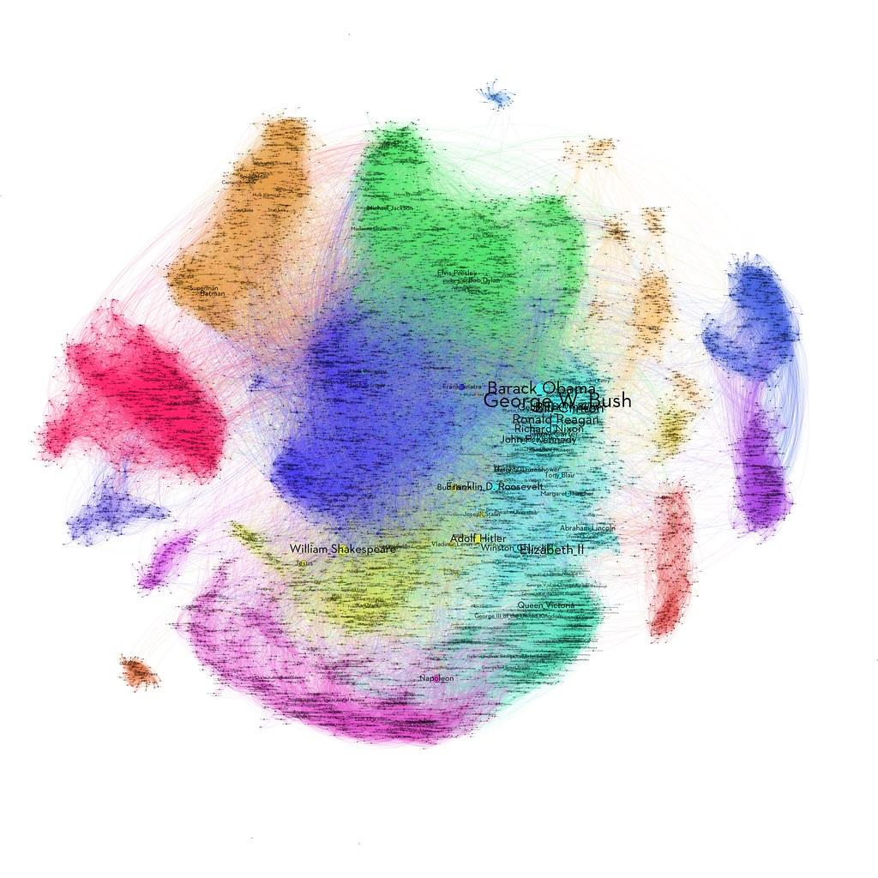
Implementation, Evaluation and Comparison of Community Detection Algorithms
Andreas Panayiotou
Theodoros Kyriakou

Slide 2
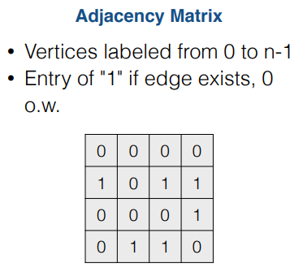

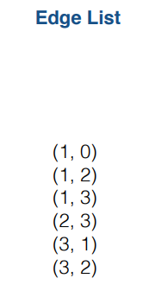
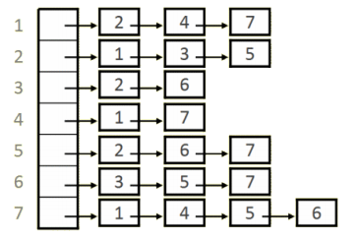
Introduction to Graphs
Graph: A graph is an abstract data type that can be used to represent complex relationships between objects. A graph consists of nodes (also called vertices) that are connected by edges.
Graph Representation Methods:

Slide 3
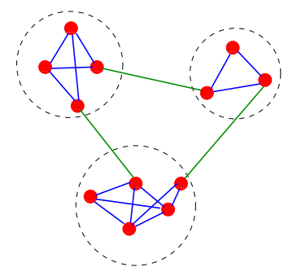
Problem Definition
Given a graph G=<V,E>
Community detection problem: find modules and their hierarchical organization.
Study and Implement algorithms that will find set of nodes which lead to “good communities”
Evaluate the results. Are the communities “good”?
Community detection in networks was a classic problem in graph theory for many years.
Many algorithms and methods have been published to solve that problem.

Slide 4
History of Graph Partitioning
The graph partitioning problem was a classic problem in graph theory.
The initial problem was:
How to split a network in k equal parts such that there is a minimal number of edges between part.
Variants were proposed:
What if partitions are not exactly same size ?
What if the number of parts is not exactly k ?
...
Girvan & Newman in 2002 introduced the problem of “community discovery”
Found that social networks are very often composed of groups
Number and the size of these groups is not known
Is there a way to discover automatically those groups ?

Slide 5
Communities and Applications
Community Structure
Vertices in networks are often found to cluster with a high density of within-group edges and a lower density of between-group edges.
Applications:
Social Networks:
Identify web clients with similar interest and geographically near each other.
Marketing:
Identify customers with similar interests (ex. Using the purchasing history)
Politics

Slide 6
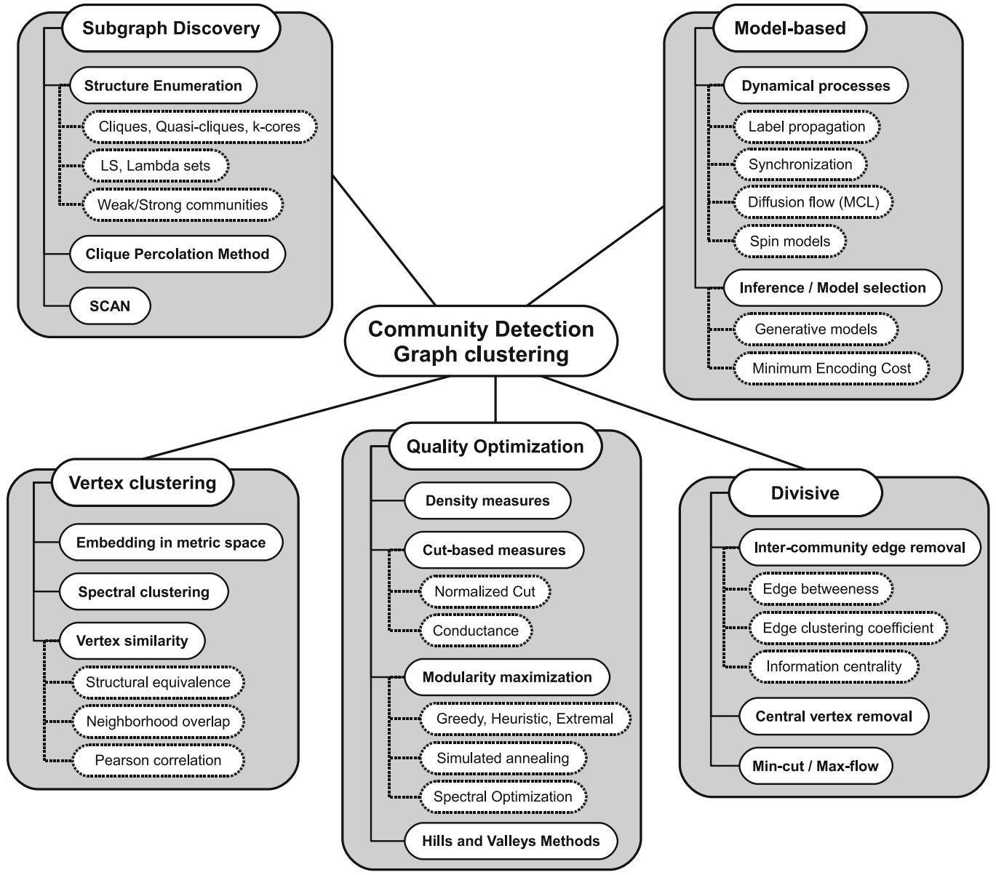
Algorithms
Many different approaches to solve the community detection problem.
In this work we have studied and implemented the following algorithms:
Label Propagation Algorithm
(Raghavan et al. 2007)
Louvain Algorithm
(Blondel et al. 2008)
Girvan and Newman Algorithm
(Girvan and Newman 2002)
Symeon Papadopoulos, Yiannis Kompatsiaris, Athena Vakali, Ploutarchos Spyridonos, “Community detection in Social Media”, 2011

Slide 7
Label Propagation Algorithm
Usha Nandini Raghavan, Reka Albert, Soundar Kumara, Near linear time algorithm to detect community structures in large-scale networks, The Pennsylvania State University, 2007
Fast algorithm
Based on network structure as its guide
The main idea is that:
The community that each node in the network will have, is the community which most of its neighbours belong.
A single label can quickly become dominant in a densely connected group of nodes.
But will have trouble crossing a sparsely connected region.
Labels will get trapped inside a densely connected group of nodes.

Slide 8
Label Propagation Pseudocode
Initialize the labels at all nodes in the network.
Set t = 1.
Arrange the nodes in the network in a random order and set it to X
For each x ∈ X chosen in that specific order, let Cx(t) = f(...)
f here returns the label occurring with the highest frequency among neighbors
If every node has a label that the maximum number of their neighbors have, then stop.
Else, set t = t + 1 and go to (3)

Slide 9
Label Propagation Example

Slide 10
Modularity
Measures the strength of division of a network into communities
each node belongs to one and only one community
Networks with high modularity have:
dense connections between the nodes within communities.
sparse connections between nodes in different communities.
Ranges between -1 and 1. The more positive the value of the more significant the grouping.
It compares:
the observed fraction of edges inside communities
to the expected fraction of edges inside communities in a random network

Slide 11

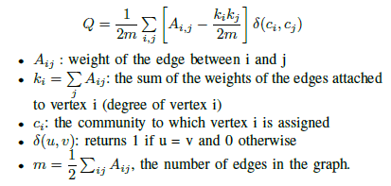
Modularity (Cont.)
Approximation of the probability of an edge existing between nodes i and j
(based on Configuration model)

Slide 12
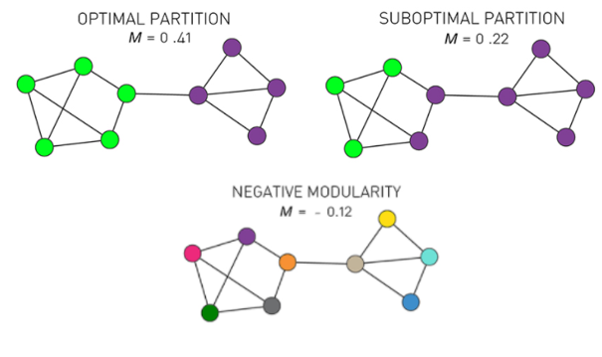
Optimal Partition: The partition with maximal modularity M=0.41 closely matches the two distinct communities.
Suboptimal Partition: A partition with a sub-optimal but positive modularity, M=0.22, fails to correctly identify the
communities present in the network..
Negative Modularity: If we assign each node to a different community, modularity is negative, obtaining M=-0.12.

Slide 13
Louvain Algorithm
Blondel V D, Guillaume J-L, Lambiotte R and Lefebvre E, Fast unfolding of communities in large networks, Universit´e catholique de Louvain, 2008.
Fast, greedy algorithm
Based on the maximization of modularity.
Divided in 2 phases:
Modularity Optimization: assign communities to the nodes until no improvements can be achieved
Community Aggregation: build a new graph whose nodes are now now the communities found during the first phase

Slide 14


Louvain Pseudocode
Phase 1:
Each node in the network is assigned to its own community.
For each node, the gain in modularity is found by removing the node from its current community, and then moving it into the community of each neighbor of j.
Node is then moved to the community that resulted in the greatest increase of modularity. If no increase is possible, remains in its original community.
Repeat from step 2 until no change in modularity is possible.
Gain in modularity can be calculated using:
Term 1: Modularity after merging two clusters
Term 2: Modularity before merging two clusters

Slide 15
Louvain Pseudocode (Cont.)
Phase 2:
Edges between nodes of the same community are now represented as self loops.
Edges from multiple nodes in the same community to a node in a different community are represented as weighted edges between the two communities.
Phase 1 is now run with this new smaller graph.
This is repeated until no gain in modularity is possible or graph combined to a single node.

Slide 16
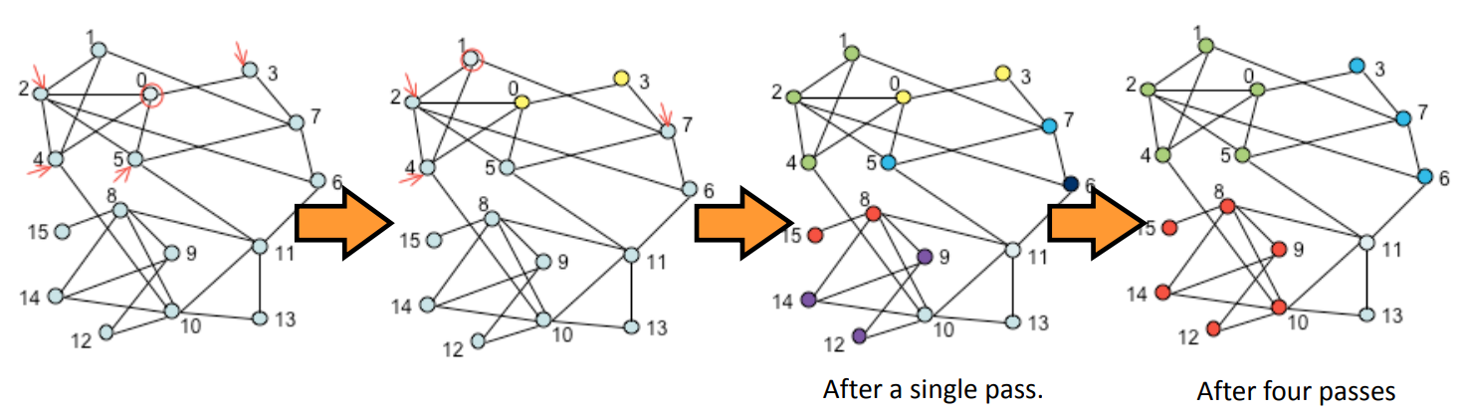
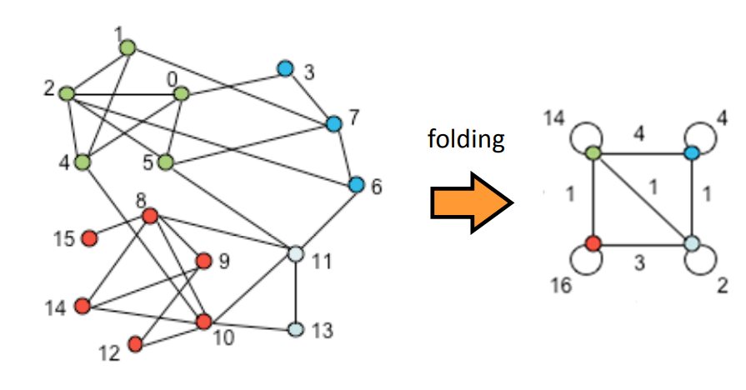
Phase 1
# of edges from nodes in Blue to nodes in Green
Phase 2
# of intra community edges (Blue)

Slide 17
Source: https://www.youtube.com/watch?v=dGa-TXpoPz8&ab_channel=ArtificialIntelligence-AllinOne
(Video deleted due to email size limitations)

Slide 18
Girvan Newman Algorithm
Michelle Girvan and M. E. J. Newman, Community structure in social and biological networks, 2001.
Main idea:
Iterative elimination of edges with the highest number of the shortest paths that pass through them.
Based on Betweenness Centrality:
High BC(v) indicates high traffic pass from node v.
Very time consuming, may use approximation

Slide 19
Girvan Newman Pseudocode
Calculate the betweenness for all edges in the network.
Remove the edge(s) with the highest betweenness.
Recalculate betweennesses for all edges affected by the removal.
Repeat from step 2 until no edges remain.

Slide 20
Example of Girvan Newman Algorithm
Assume we have the graph below
BFS run on A
A
B
C
A
D
E
F
B
D
C
E
F

Slide 21
Number of shortest Paths from Node A to every other Node
BW on each Edge
We start on node F that is on the bottom
We divide the quantity according to the value of each node that is connected
A
1
1+1.33+0.835=3.165
A
1+0.835=1.835
1
B
D
1
B
D
1+0.33=1.33
1.67/2=0.835
1.67/2=0.835
As we move further, we add 1 on each node
1
C
E
2
C
E
1+0.67=1.67
1/3=0.33
2/3=0.67
F
3
F

Slide 22
B
C
D
1.5
1.5
3.165
1.835
3.165
2
1.835
1
A
E
1
C
1
1
B
F
1
A
E
1.33
0.835
1.33
0.5
0.5
0.5
0.5
0.835
0.835
0.835
2
D
F
2
1
A
E
2
2
B
F
1
0.33
0.67
0.67
0.33
3
D
C
E
3
F
1.5
1.5
1.835
3.165
2
1
D
1
B
F
1
1
C
E
1
0.5
0.5
0.5
0.835
0.835
1.33
0.5
A
C
2
B
D
1
2
2
0.67
0.33
A
3

Slide 23
A
B
C
D
E
F
Edge | Edge Betweenness
AB | 3.165 + 1.5 + 1.33 + 0.835 + 0.5 + 0.67 = 8
AD | 1.835 + 0.5 + 0.33 + 1.835 + 0.5 + 0.33 = 5.33
BC | 3.165 + 1.5 + 1.33 + 0.835 + 0.5 + 0.67 = 8
BE | 0.835 + 2 + 0.835 + 0.835 + 2 + 0.835 = 7.34
CF | 1.835 + 0.5 + 0.33 + 1.835 + 0.5 + 0.33 = 5.33
DE | 3.165 + 1.5 + 1.33 + 0.835 + 0.5 + 0.67 = 8
EF | 3.165 + 1.5 + 1.33 + 0.835 + 0.5 + 0.67 = 8

Slide 24
A
8
B
8
C
5.33
7.34
5.33
D
8
E
8
F
Because this is an undirected graph, we divide by 2
A
4
B
4
C
2.67
3.67
2.67
D
4
E
4
F

Slide 25
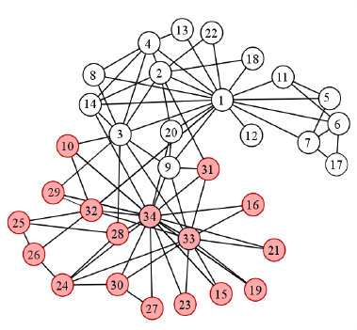
Evaluation
Use of a dataset with known ground-truth communities.
We assume that the community membership for each vertex is known.
Zachary’s Karate club Network
34 nodes
78 edges
In order to evaluate our algorithms, we use the following methods:
Mutual Information (MI)
Normalized Mutual information (NMI)
Rand Index (RI)
Adjusted Rand Index (ARI)

Slide 26
Mutual Information (MI)
Compare two distinct partitions of a single data set
by calculating the amount of information they share.
Based on how much knowing one variable reduces uncertainty about the other.
A non-negative value
higher the value, the more information is shared between two partition X and Y
We have also used the normalized version of Mutual information the NMI, which is bounded in the range 0 and 1, and again higher value means the partition that was produced is more similar to the ideal.

Slide 27


Mutual Information (MI) Score

Slide 28
Rand Index (RI)
Compares how two partitions handle each potential pair of nodes
Rand Index score ranges between 0 and 1
higher value ➡ better output
We have used also the Adjusted Rand score which produce more accurate results in case the number of truth communities are not the same with the number of the communities that the algorithm produced.

Slide 29
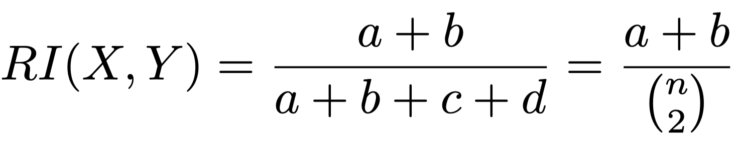
Rand Index (RI) Score
n: number of nodes
a: number of pairs which are in the same community in X and in the same in community Y
b: number of pairs which are in different communities in X and in different communities in Y
c: number of pairs which are in same community in X and in different communities in Y
d: number of pairs which are in different communities in X and in same community in Y

Slide 30
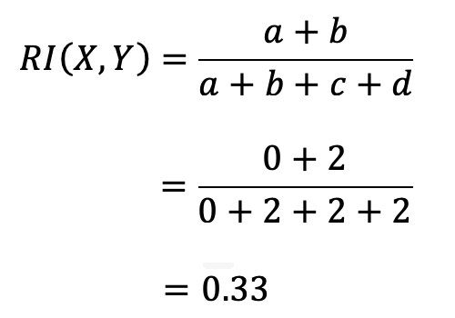
Rand Index (RI) Score - Example
 | Same - X | Different - X
Same - Y | a | d
Different - Y | c | b
Clustering X: 1, 2, 2, 1
Clustering Y: 2, 1, 2, 1
All possible pairs: [1,2], [1,3], [1,4], [2,3],[2,4],[3,4]
X, [1,2] => (1,2) => 1 ≠ 2
Y, [1,2] => (2,1) => 2 ≠ 1
b += 1
X, [1,3] => (1,2) => 1 ≠ 2
Y, [1,3] => (2,2) => 2 = 2
d += 1
X, [1,4] => (1,1) => 1 = 1
Y, [1,4] => (2,1) => 2 ≠ 1
c += 1
X, [2,3] => (2,2) => 2 = 2
Y, [2,3] => (1,2) => 1 ≠ 2
c += 1
X, [2,4] => (2,1) => 2 ≠ 1
Y, [2,4] => (1,1) => 1 = 1
d += 1
X, [3,4] => (2,1) => 2 ≠ 1
Y, [3,4] => (2,1) => 2 ≠ 1
b += 1

Slide 31
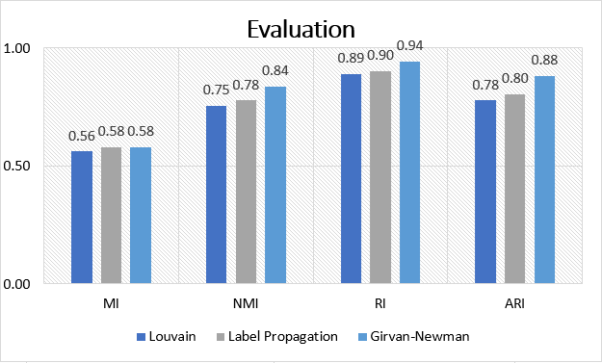
Evaluation Results

Slide 32
Computational Complexity
 | Complex-A | Complex-B
Label Propagation | O(n²) | O(n)
Louvain | O(n²) | O(n)
Girvan Newman | O(n⁵) | O(n³)
Complex-A: general graphs irrespective of density
Complex-B: assumption that the graph is sparse
Symeon Papadopoulos, Yiannis Kompatsiaris, Athena Vakali, Ploutarchos Spyridonos, “Community detection in Social Media”, 2011

Slide 33
Conclusion and Future Work
Very interesting topic in graph theory.
Many applications in real world problems
Future Work:
Use the implemented algorithms to extract useful information
Study and implement more algorithms that solve the same problem like:
WalkTrap
Infomap
Also K-Means is an other interesting approach to the problem that uses nearest mean but the number of communities is needed before execution.

